Slide 1
FIN-MAN GAME Financial Management
Presented by
Priyanka Bolla
Mounisri Muppidi
Phase-3 presentation
CIS680 : Software Engineering Project

Slide 2
Table of contents
Our conditions
Final Result
The Secret Sauce
Proof of Correctness
Overall Experience
Reflections on process and results
References

Slide 3
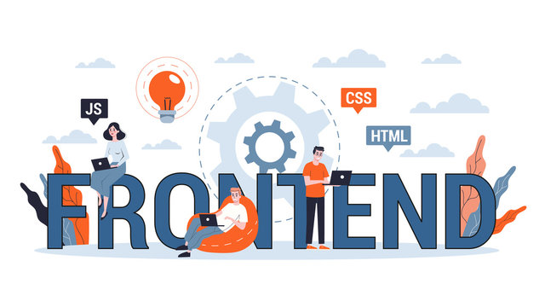
My conditions
We utilized the ReactJS framework as the foundation of our front-end development, allowing us to handle mathematical computations and render a user interface using HTML, CSS, and MaterialUI - an easy-to-use UI library.
As a result, we chose to develop our project entirely in the JavaScript programming language..

Slide 4
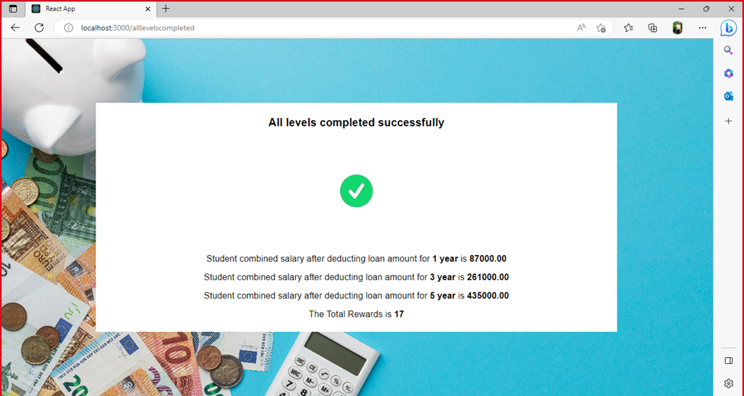
My Final Result
MY FINAL RESULT

Slide 5
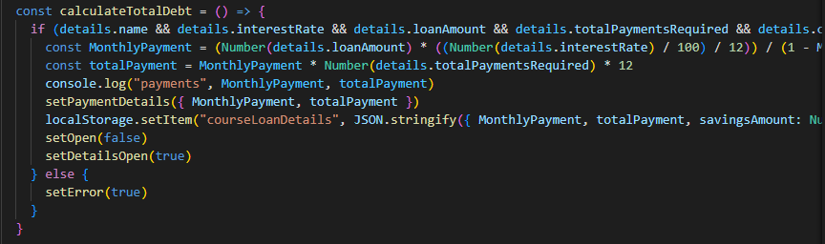
Secret Sauce-1

Slide 6
Secret Sauce-2

Slide 7
DEMO

Slide 8
Proof of Correctness

Slide 9
Overall Experience-What went smoothly
Effective communication: Good communication between us which included regular meetings and status updates, as well as feedback .
Clear project requirements: Having a clear understanding of what features and functionalities the app needs will help ensure that development progresses smoothly.
Well-defined architecture: helped to ensure that the codebase is organized and modular.
Proper tooling and libraries: using tools like npm or yarn for package management made process smoother.

Slide 10
Overall Experience-What was challenging
Extracting the average salary data based on the course
Designing the user flow: level by level
Complex debt calculations using savings and yearly salary
Ranking the rewards based on user selection

Slide 11
Reflection on process & results
1) Analysis and design
Arrays and maps for storing values and mathematical functions to calculate average debt and other calculations.
01

Slide 12
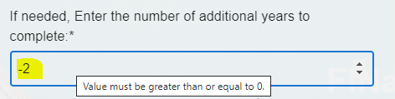
Reflection on process & results
2) Solution Options
Tested with different input values and conditions. Issues like covering all corner cases while developing the application.
Handling the user input errors-Displayed an error message.

Slide 13
Reflection on process & results
3) Decisions and improvements
We made decisions by thinking of user's perspective of using our application.
Major obstacle we faced is extracting data for average salaries based on course and how to make the flow of application.

Slide 14
REFERENCES
Gamification of learning https://en.wikipedia.org/wiki/Gamification_of_learning
What Video Games Have to Teach Us About Learning and Literacy https://en.wikipedia.org/wiki/What_Video_Games_Have_to_Teach_Us_About_Learning_and_ Literacy
How Gamification Can Help You Meet Your Financial Goals https://www.forbes.com/advisor/banking/how-gamification-can-help-you-meet-financial-goals/
Gamification In Finance Industry: All You Should Know https://evnedev.com/blog/development/gamification-in-finance-industry-all-you-should-know/

Slide 15

Thank you

